Slide 1
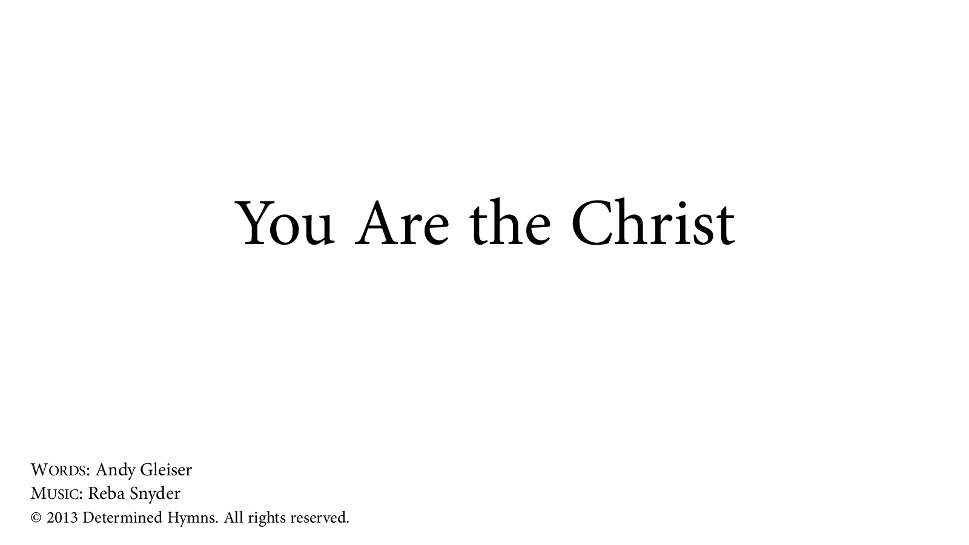
Notes:
You are welcome to use or modify these PowerPoints as needed. Feel free to change the design or layout to suit your ministry, school, home, or company. More PowerPoint slides can be found at mobilehymns.org

Slide 2
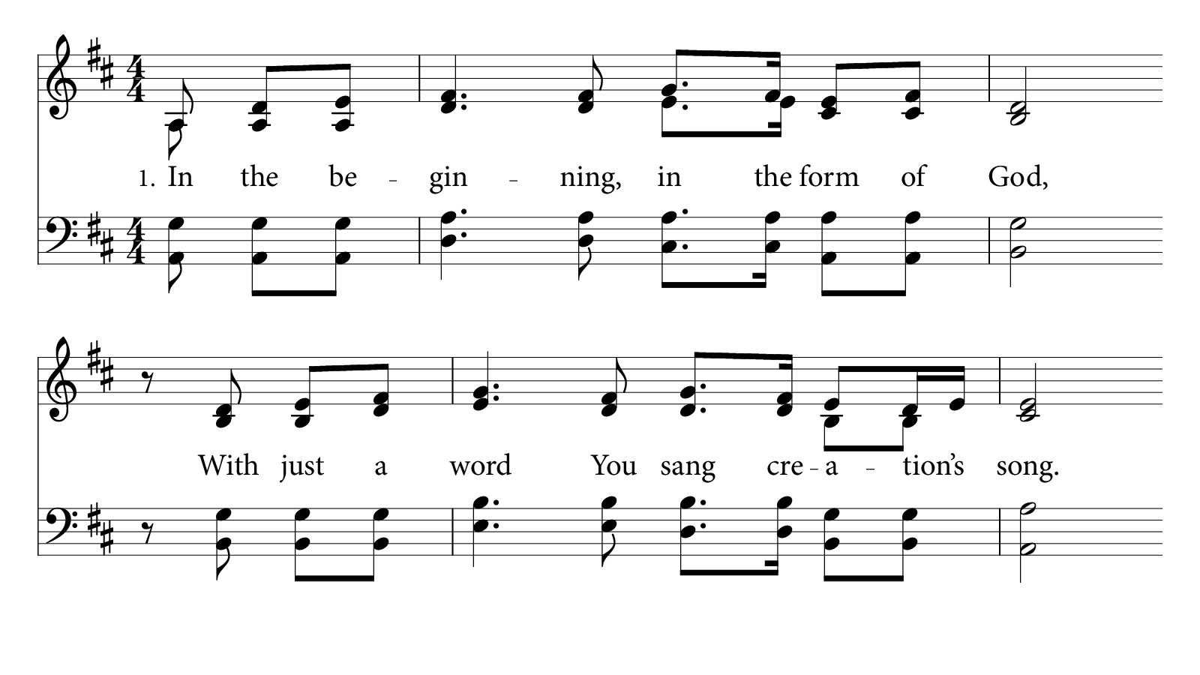

Slide 3
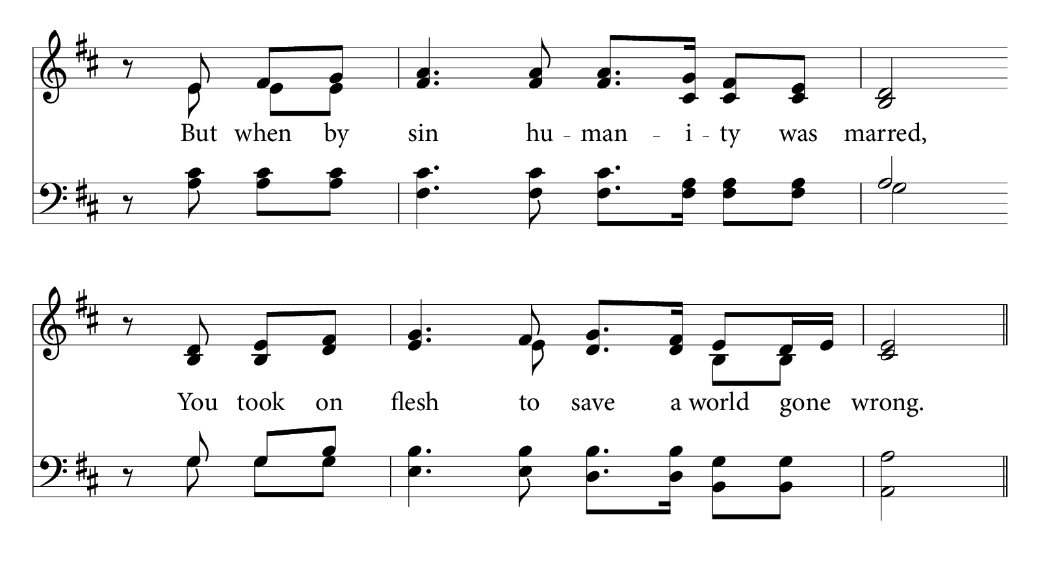
© 2013 Determined Hymns. All rights reserved.

Slide 4
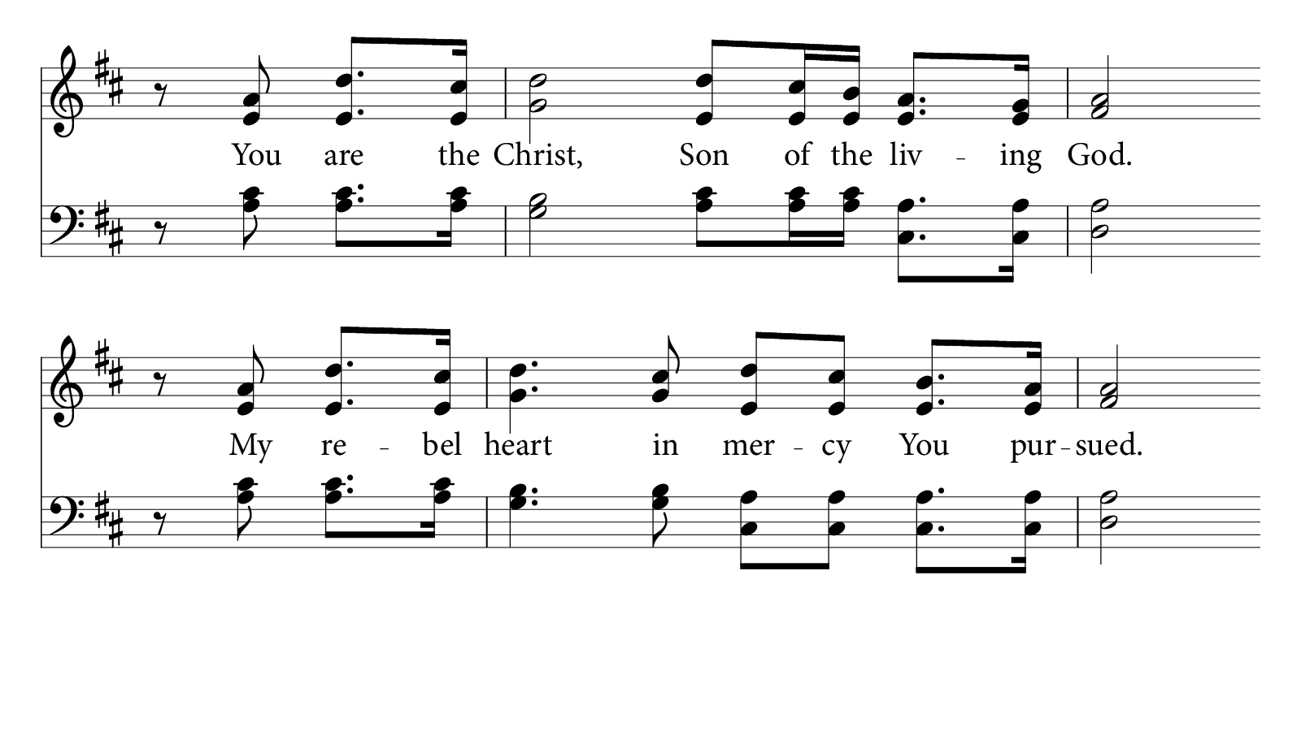
© 2013 Determined Hymns. All rights reserved.

Slide 5
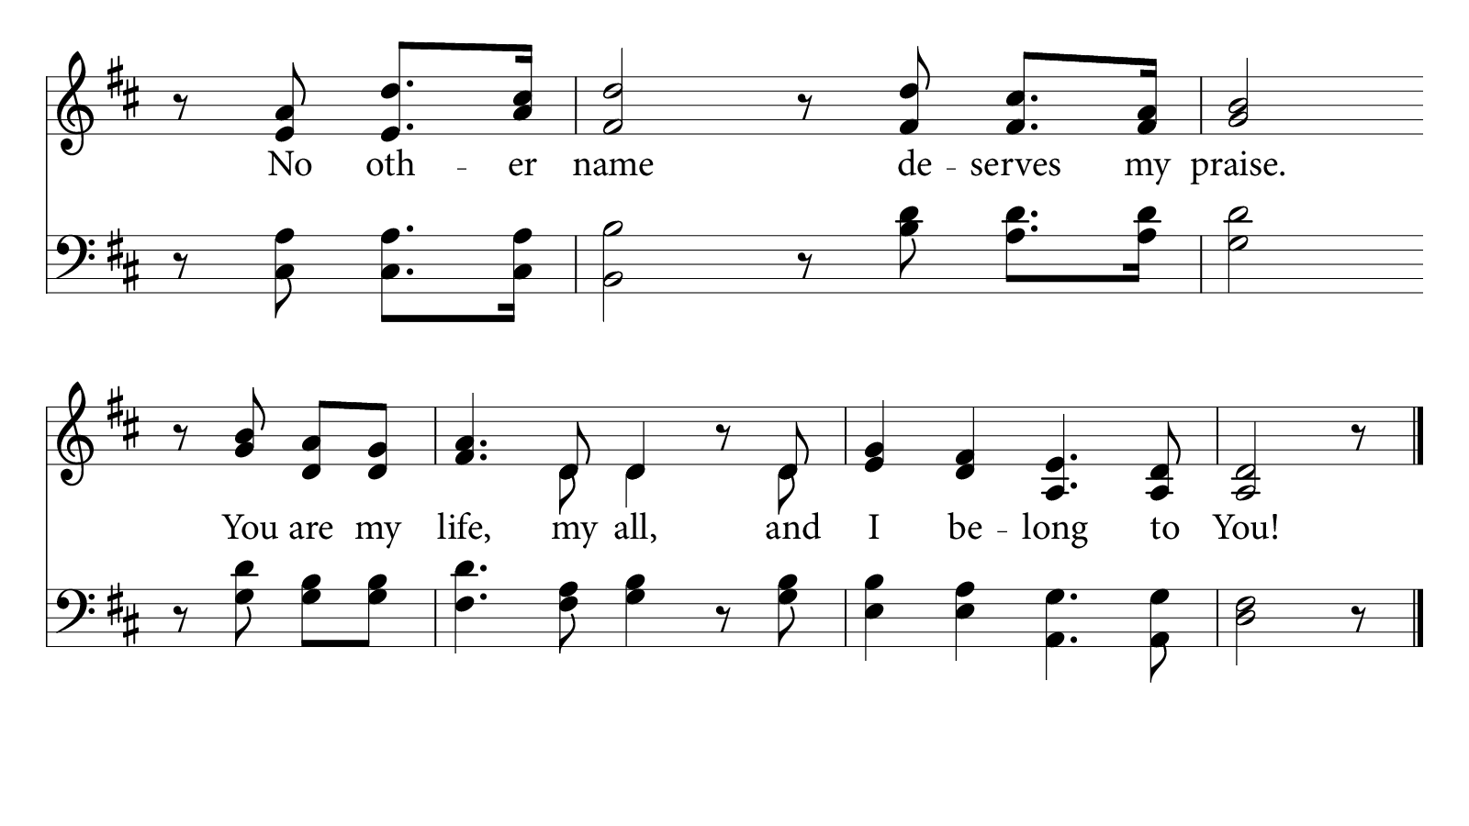
© 2013 Determined Hymns. All rights reserved.

Slide 6
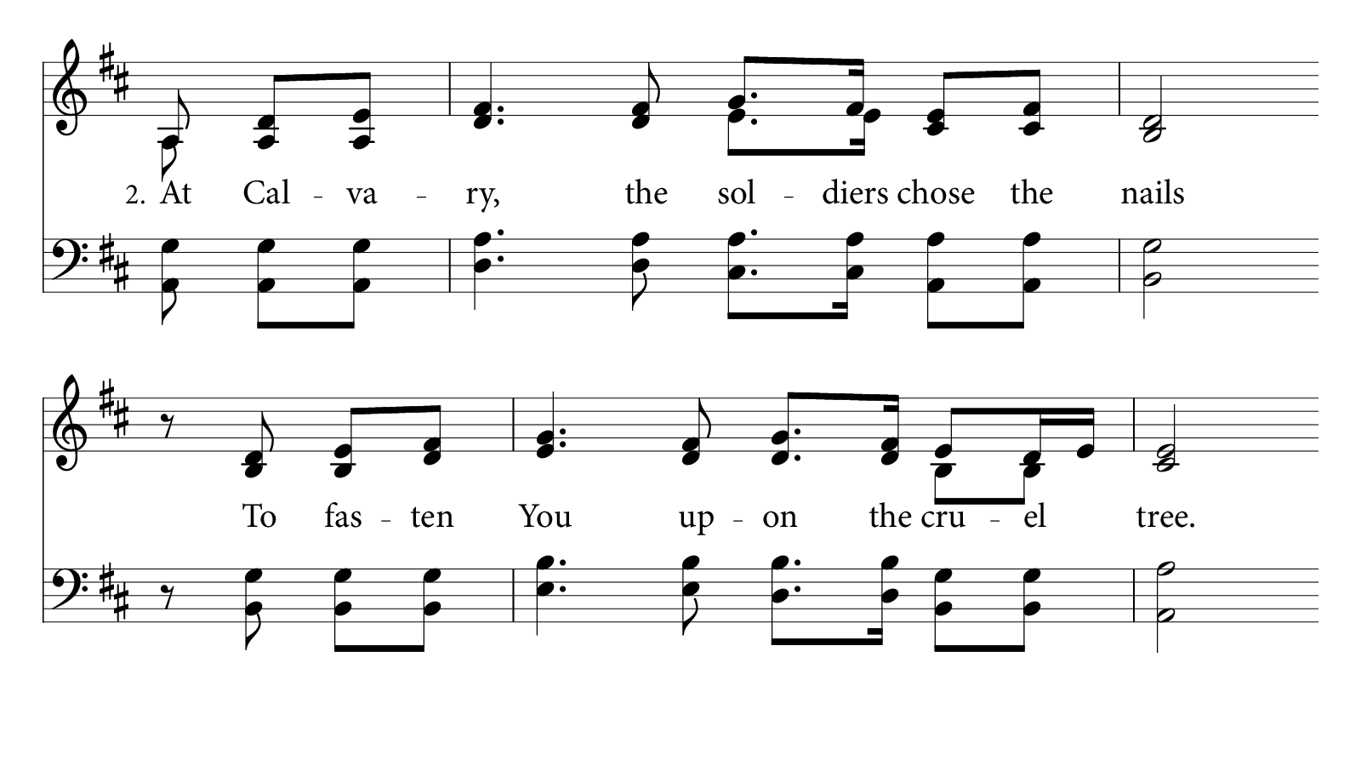
© 2013 Determined Hymns. All rights reserved.

Slide 7
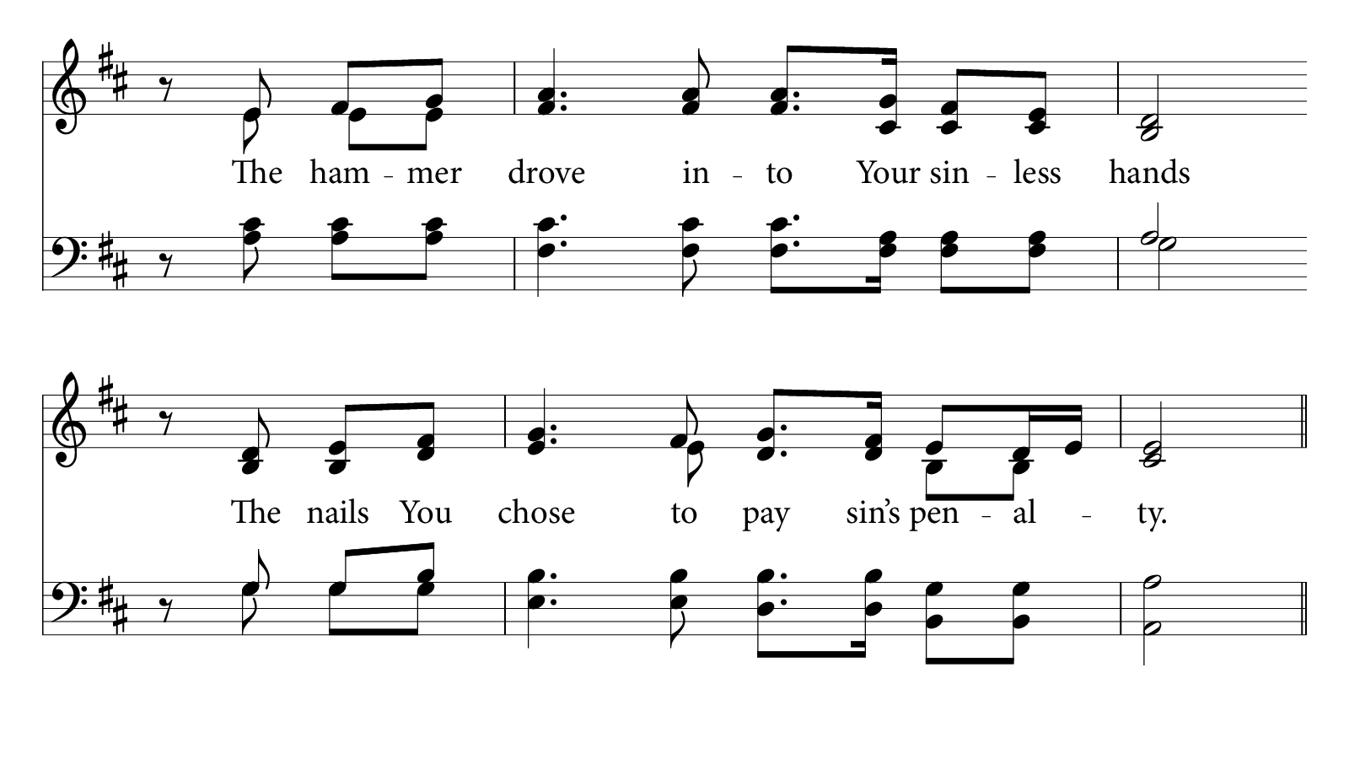
© 2013 Determined Hymns. All rights reserved.

Slide 8
© 2013 Determined Hymns. All rights reserved.

Slide 9
© 2013 Determined Hymns. All rights reserved.

Slide 10
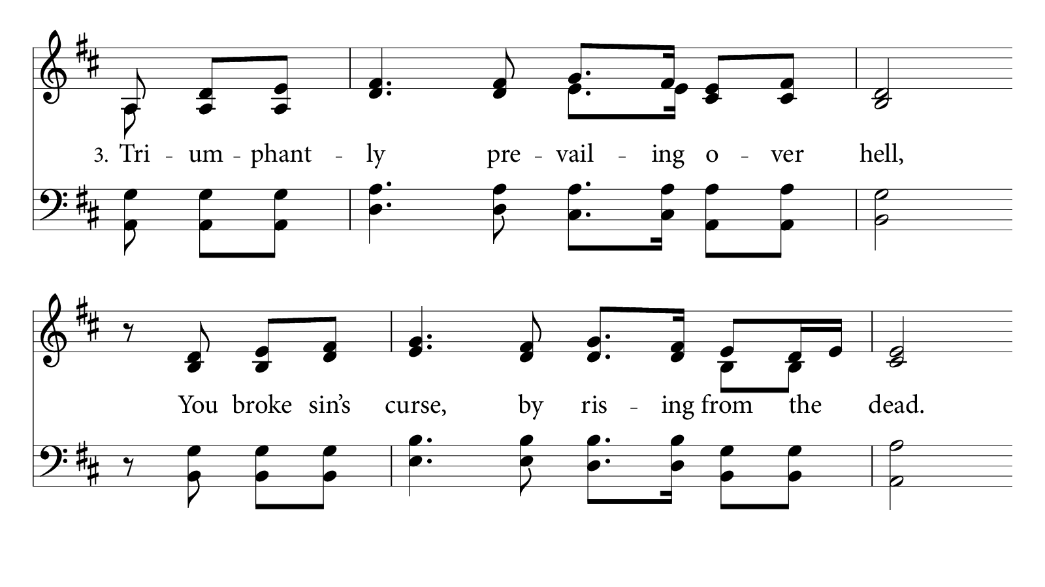
© 2013 Determined Hymns. All rights reserved.

Slide 11
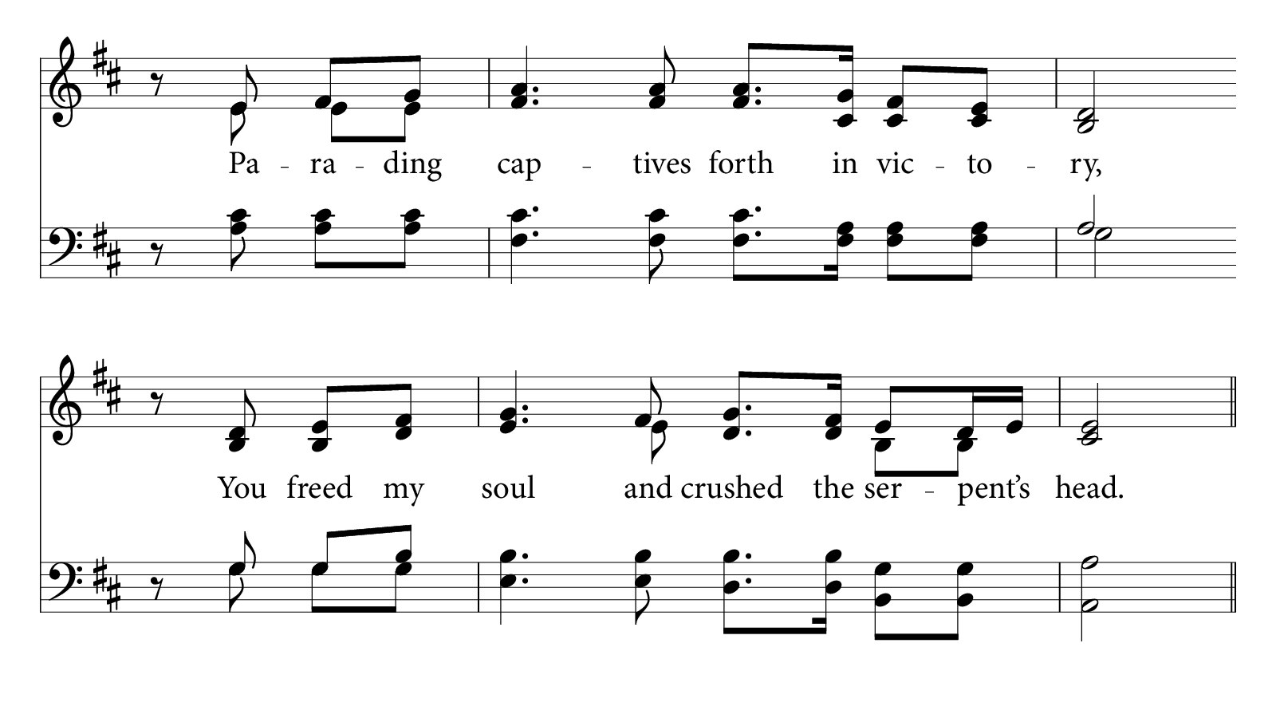
© 2013 Determined Hymns. All rights reserved.

Slide 12
© 2013 Determined Hymns. All rights reserved.

Slide 13
© 2013 Determined Hymns. All rights reserved.

Slide 14
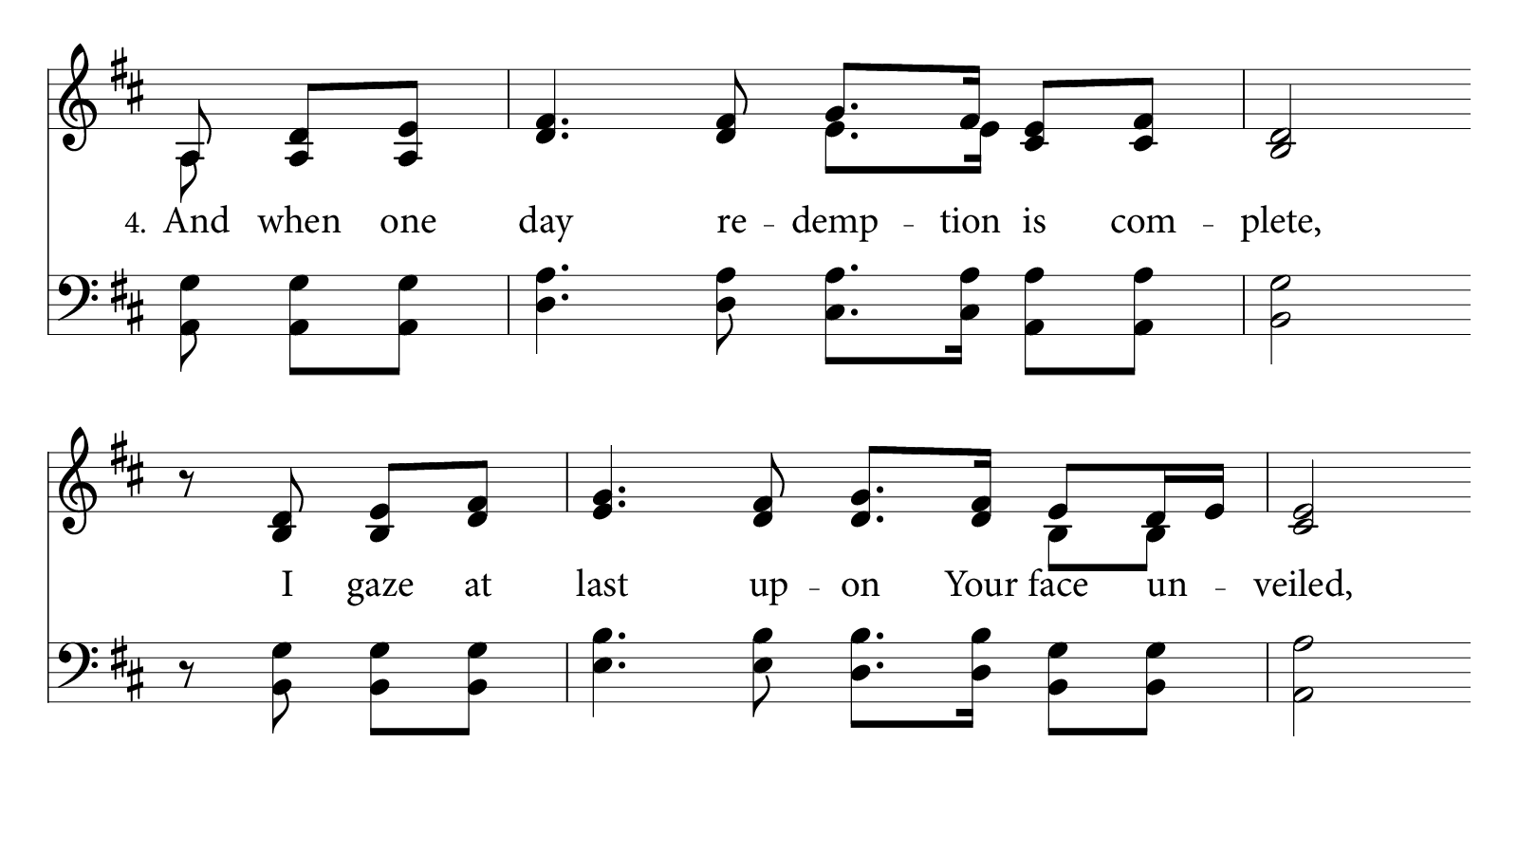

Slide 15
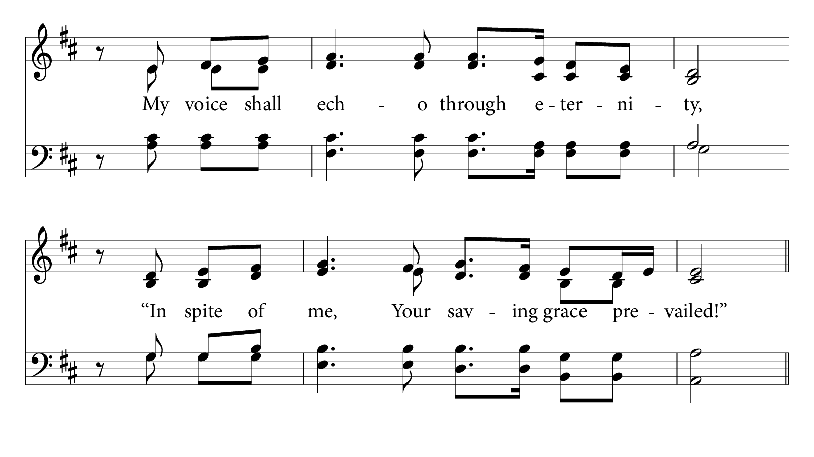
© 2013 Determined Hymns. All rights reserved.

Slide 16
© 2013 Determined Hymns. All rights reserved.

Slide 17

© 2013 Determined Hymns. All rights reserved.

