Slide 1
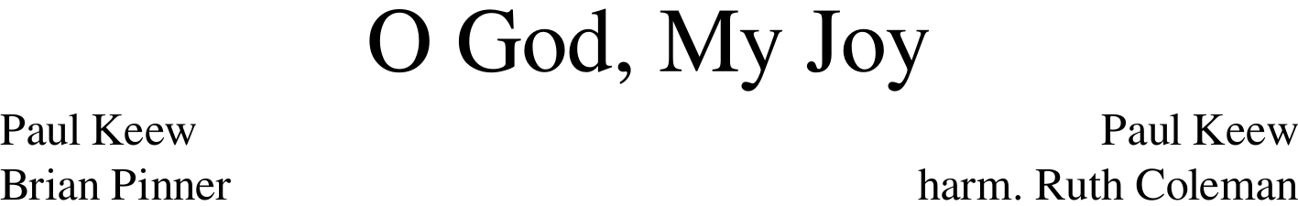
Notes:
Official permission to use the hymns posted is granted under the following conditions (a) The hymns are not to be altered in any way, (b) The hymns are to be distributed free of charge, and (c) recognition is to be given to the author and composer.
More PowerPoint slides can be found at mobilehymns.org .

Slide 2
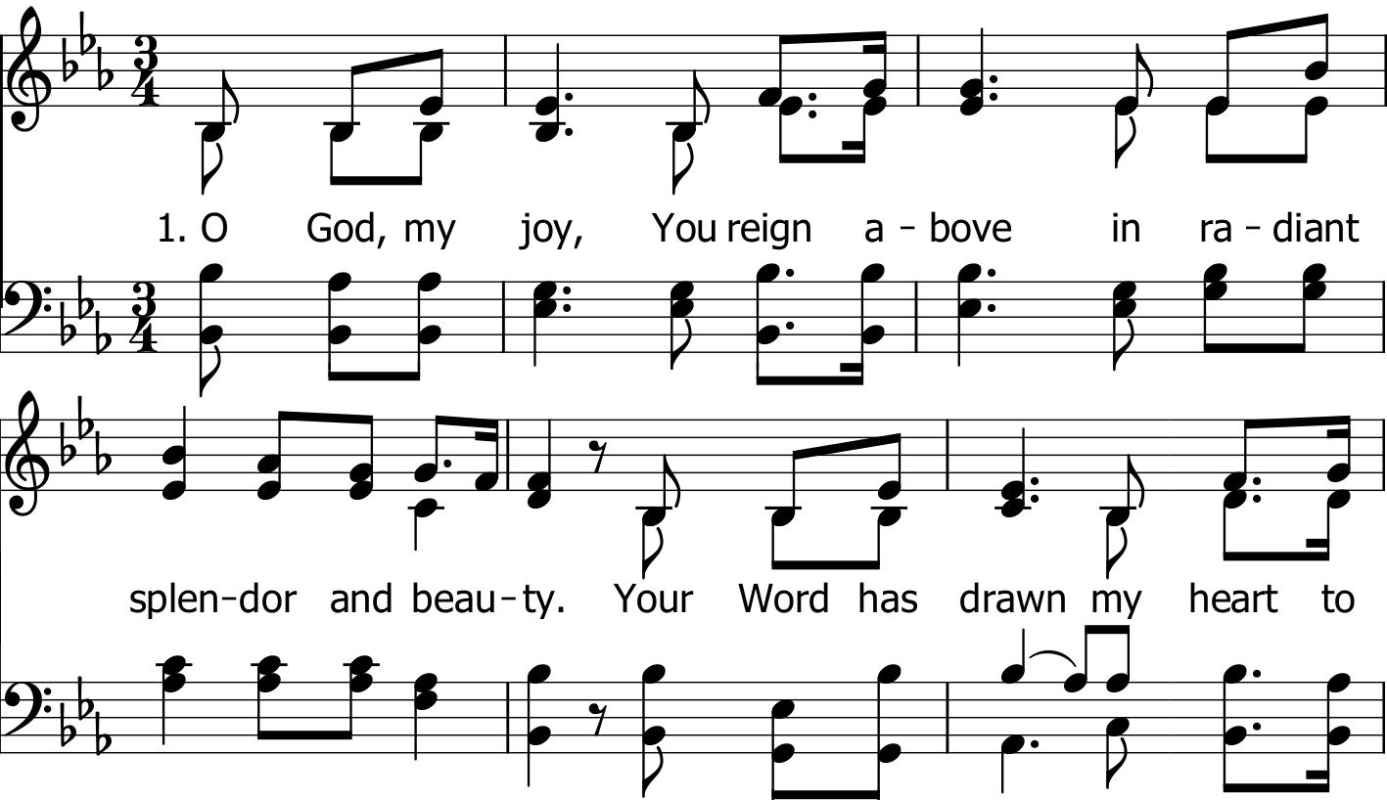

Slide 3
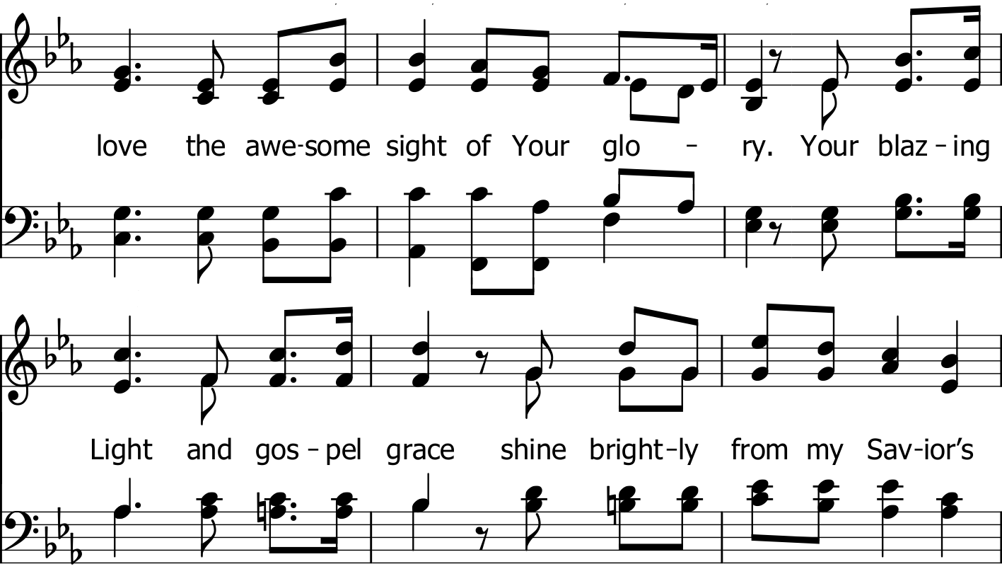

Slide 4
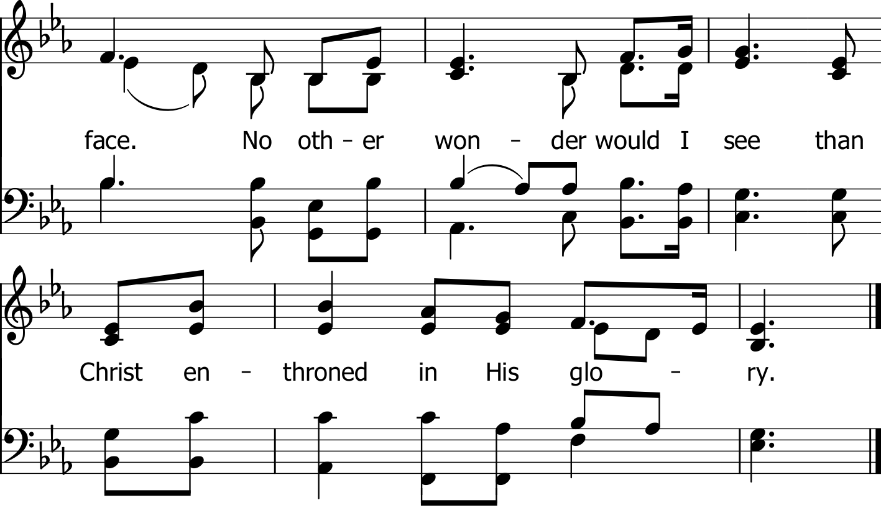

Slide 5
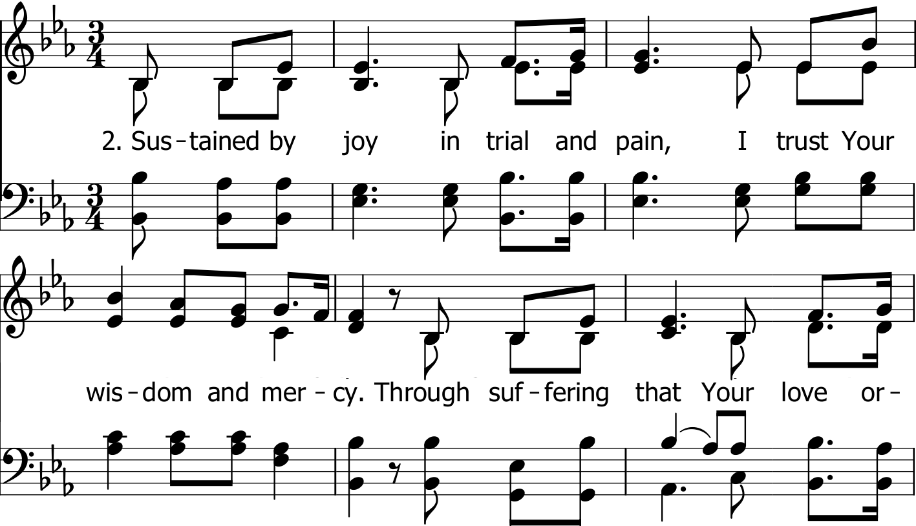

Slide 6
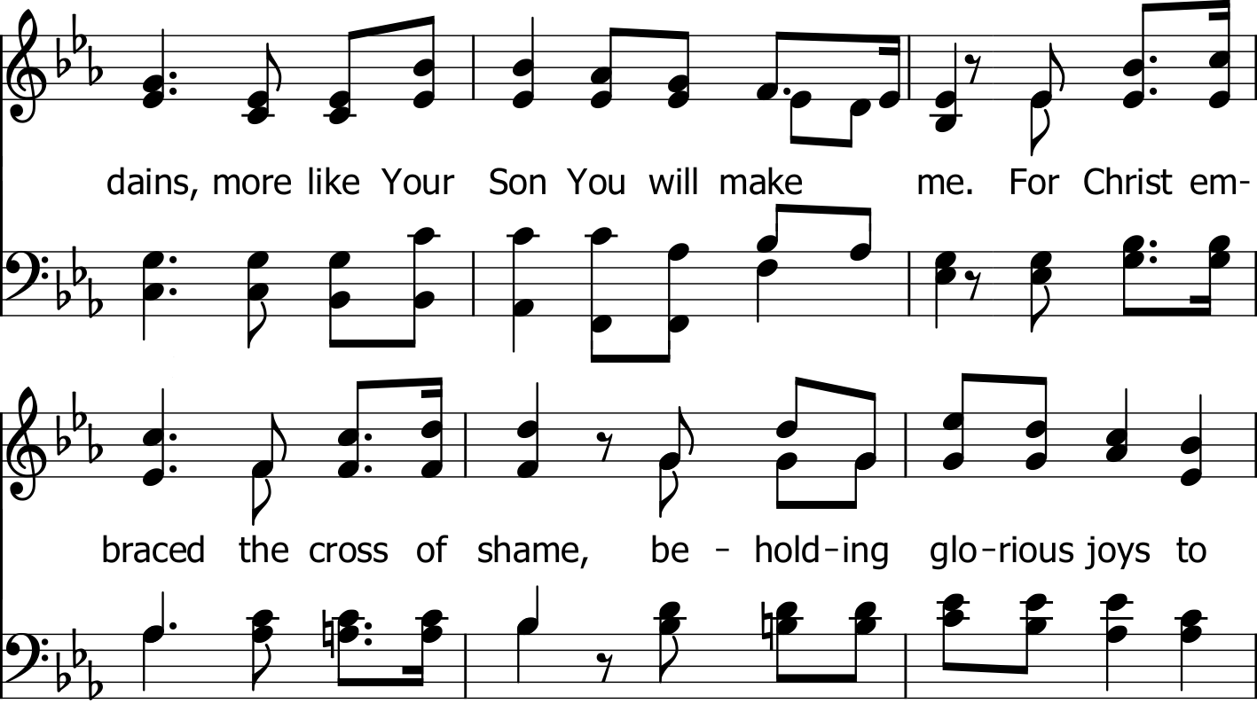

Slide 7
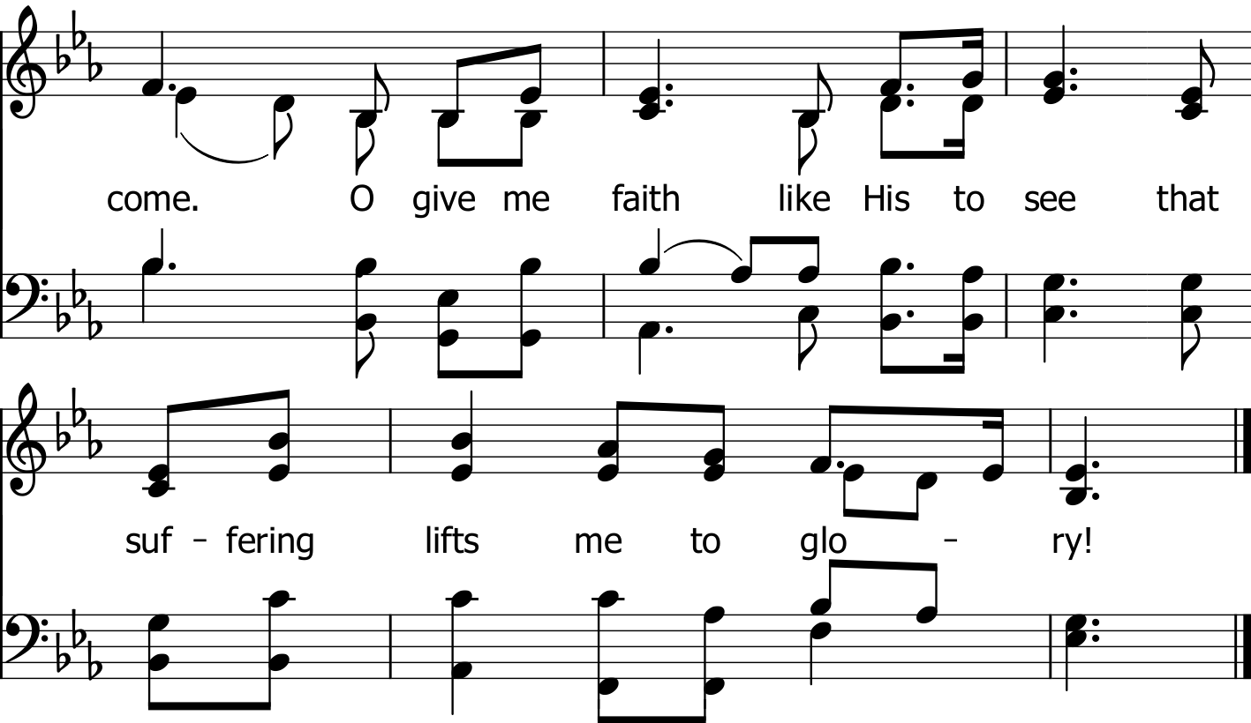

Slide 8
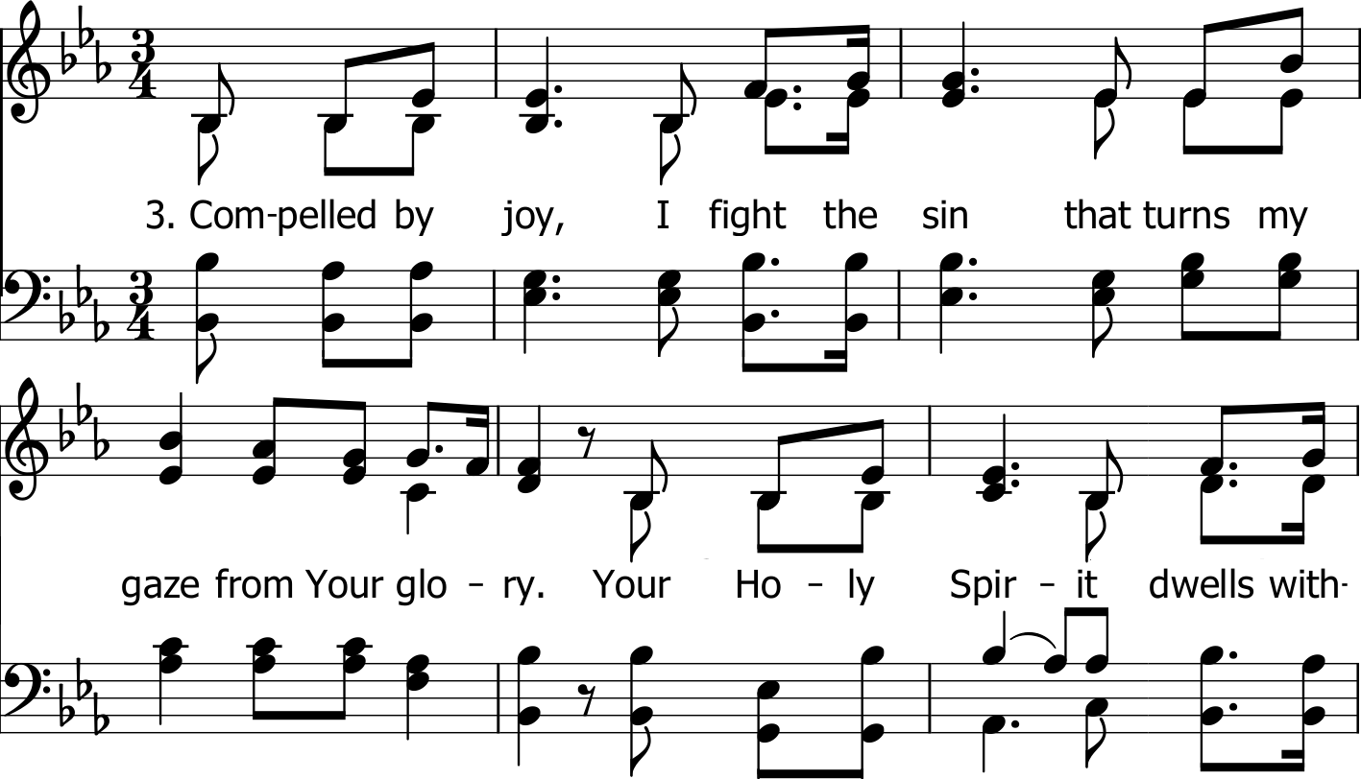

Slide 9
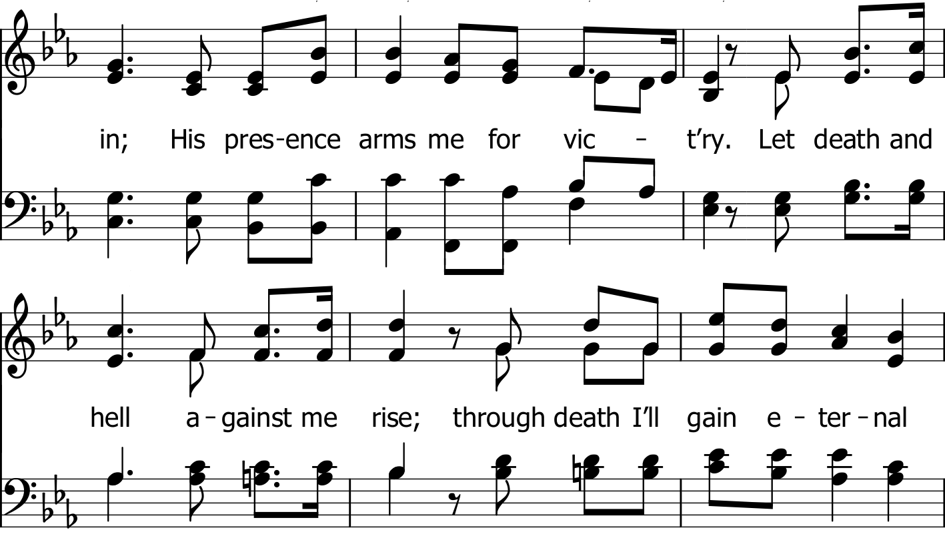

Slide 10
