Slide 1

Notes:
You are welcome to use or modify these PowerPoints as needed. Feel free to change the design or layout to suit your ministry, school, home, or company. More PowerPoint slides can be found at mobilehymns.org

Slide 2
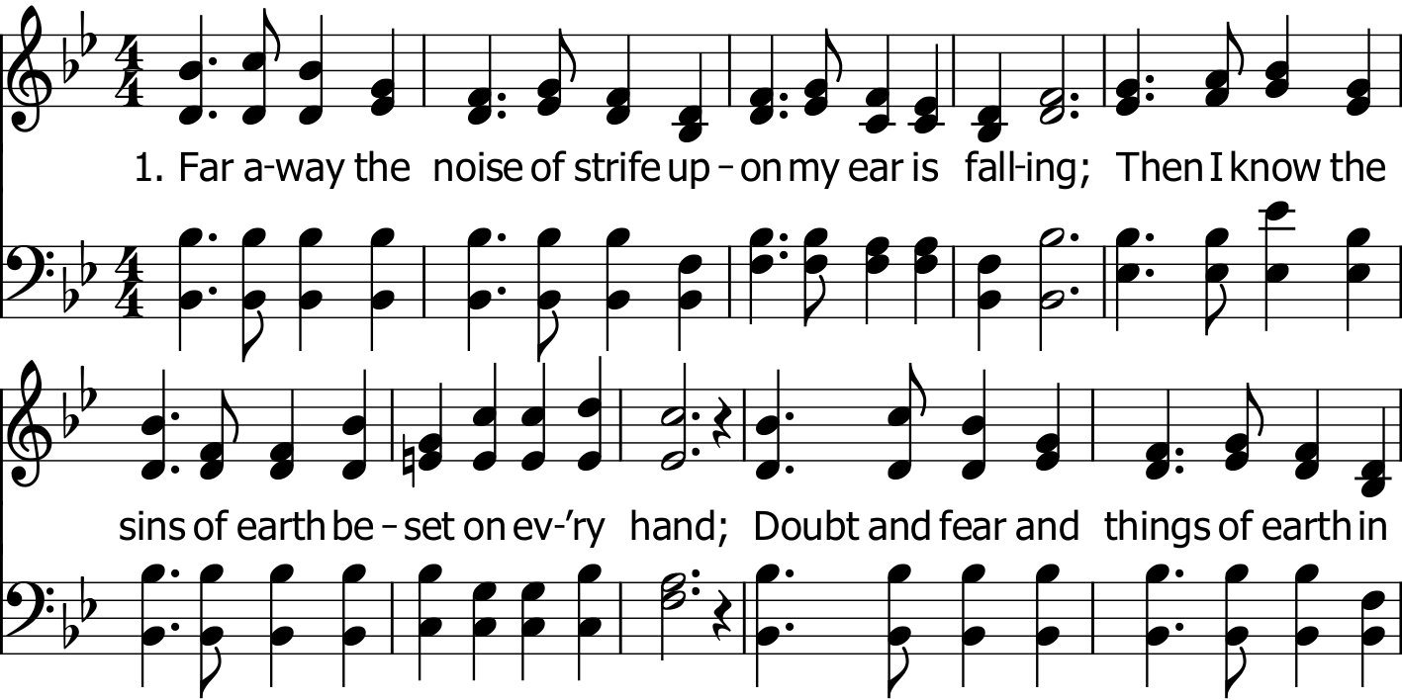
Public Domain

Slide 3
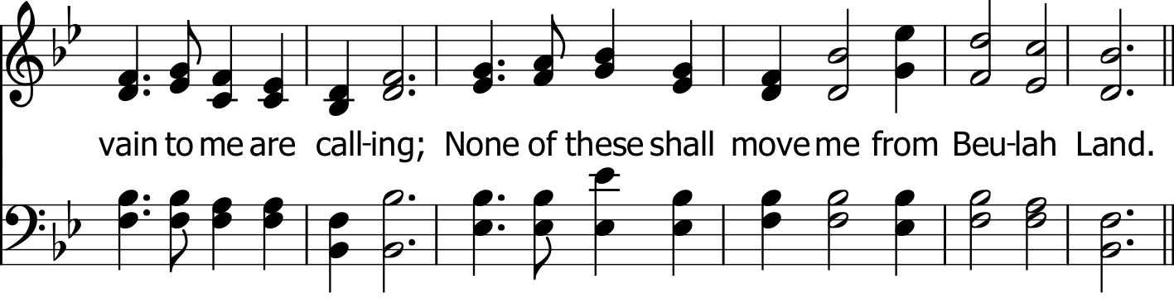
Public Domain

Slide 4
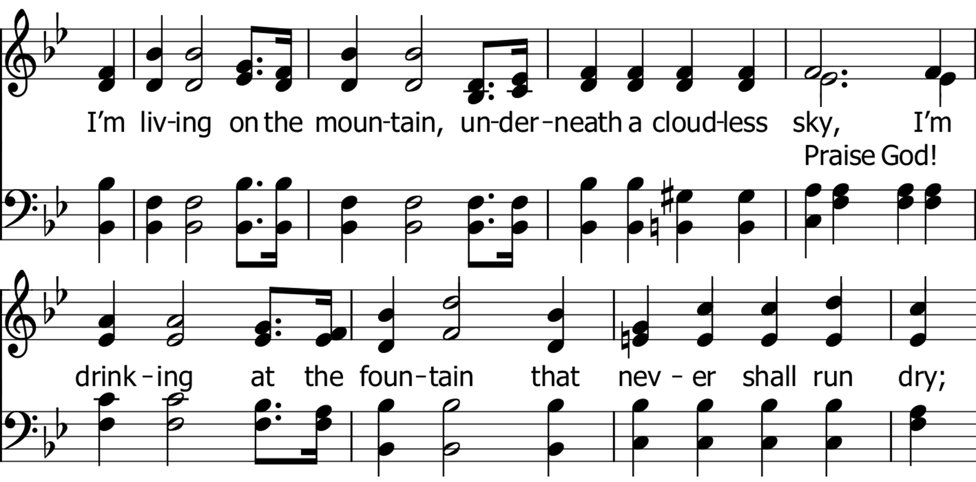

Slide 5
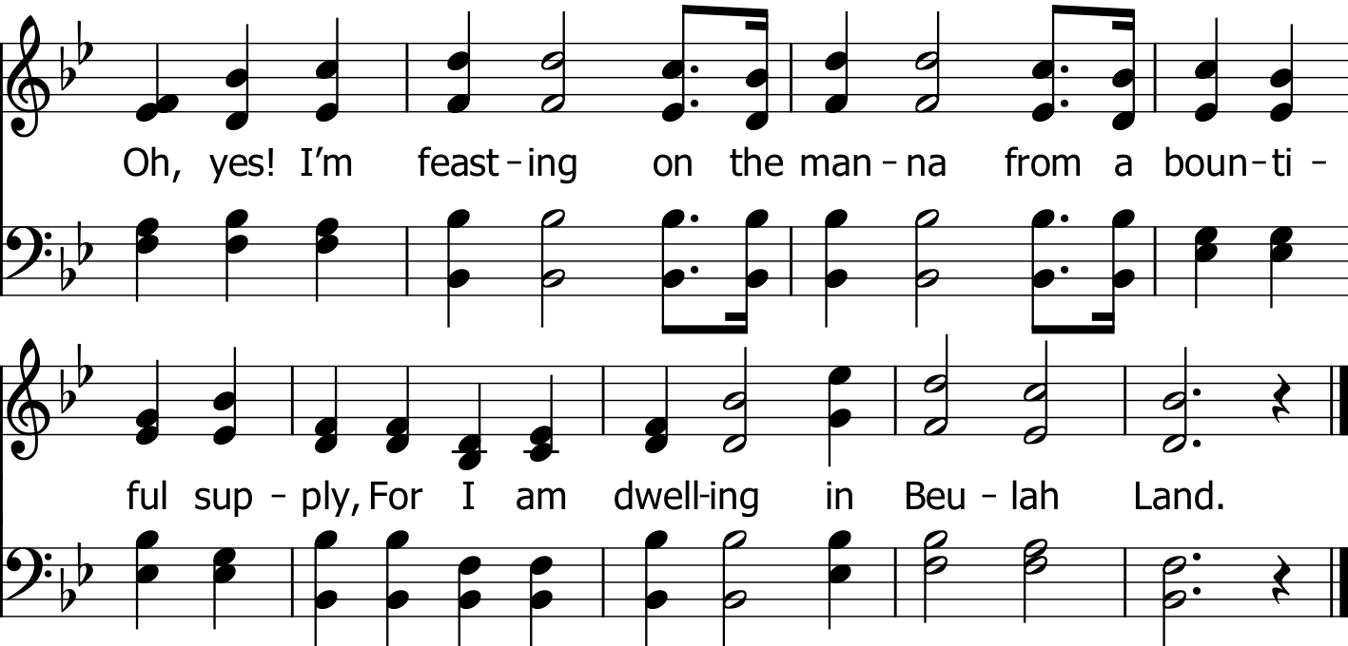

Slide 6
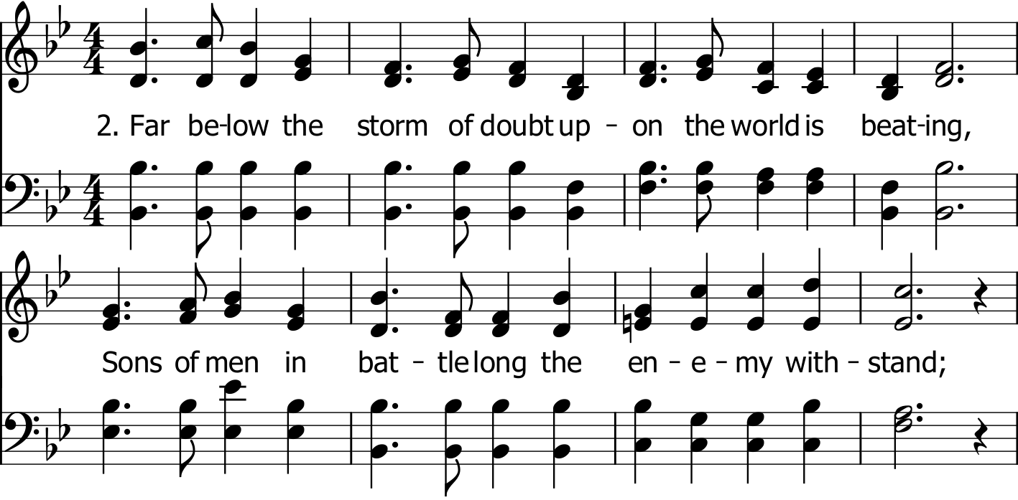

Slide 7
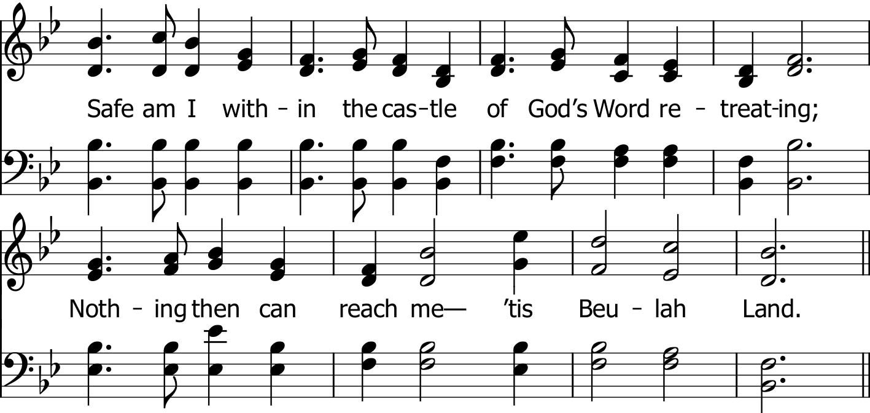

Slide 10
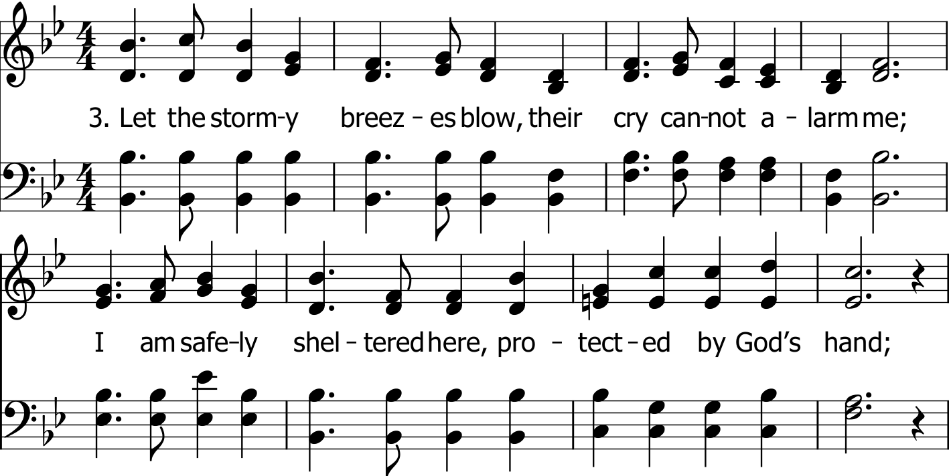

Slide 11
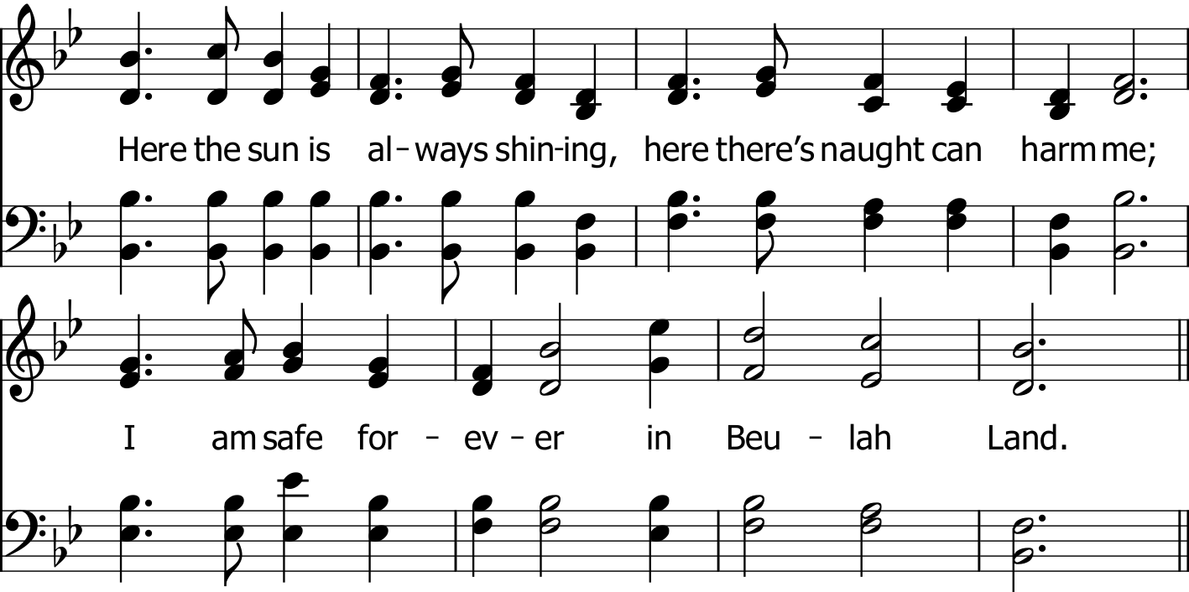

Slide 12
Public Domain

Slide 13
Public Domain

Slide 14
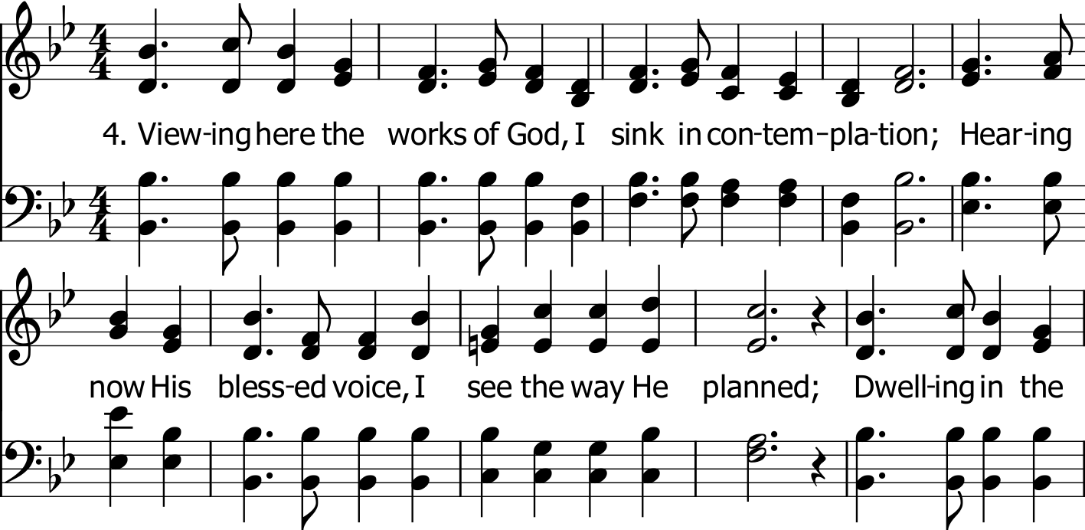
Public Domain

Slide 15
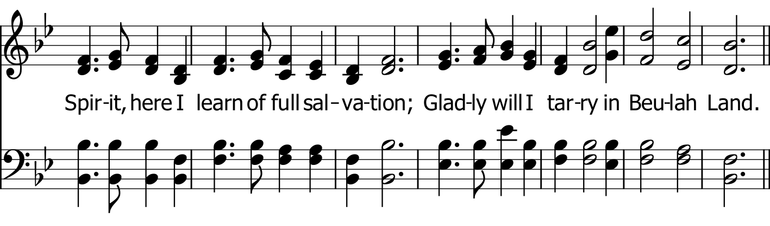
Public Domain

Slide 16
Public Domain

Slide 17
Public Domain

